Slide 1
Objectives:
Knowledge: to define the terminology (nouns, articles, genders, singular, plural)
Transition
Nouns (articles, genders, plural)
Numbers 0-100 (age, dates, time)
Questions (open, closed)
Opinions (likes/ dislikes, reasons)
Comprehension: to identify genders of nouns
Application: to transform nouns from singular to plural form

Slide 2
Pour commencer:
Look at this list of words and answer the question below
Reminder:
A verb: is a doing or action word
A noun: is a word for a person, a place or a thing
An adjective: is a word used to describe a noun
couple | mariage | mari | famille
sœur | qualité | église | fiancé
animal | copain | femme | robe
fils | raison | jeunesse | rêve
divorce | beau-père | pression | promesse
What type of words are they? a. Verbs b. Nouns c. Adjectives
Notes:
You can have this slide on the board as students come in and get settled. This is a very quick question/answer activity. These words will be looked at in the next activities. The different terms: verb, noun and adjective should be discussed with the class before moving onto the next slide.

Slide 3
Pour commencer:
In pairs and taking turns, translate (orally) each noun in English
couple | mariage | mari | famille
sœur | qualité | église | fiancé
animal | copain | femme | robe
fils | raison | jeunesse | rêve
divorce | beau-père | pression | promesse
Using a dictionary, look up any words you do not know
Notes:
Students do not need to make notes. Later, they will be asked to write the translation down to test their memory

Slide 4
Genders of nouns:
Reminder:
All French nouns have a gender: masculine or feminine
When a noun is a person, the gender is obvious - e.g: le garçon = the boy (masculine)
When a noun is a place or a thing, the gender must be learnt
Questions:
1. What is a noun?
2. Which little word (article) do you use in front of a masculine noun? (2 possible articles)
3. Which article do you use in front of a feminine noun? (2 possible articles)
Notes:
Students should read the reminder before answering the questions. Questions can quickly be answered on a mini whiteboard or as a whole class

Slide 5
 | Definite |  | Indefinite
 | French | English | French | English
masculine | le | the | un | a
feminine | la | the | une | a
How many genders can French nouns have? Which ones?
Write a definite article in English
Write the indefinite article for a feminine noun in French
What difference does it make when you use a definite or indefinite article with a particular noun? (think of: «un chat » Vs « le chat »)
Notes:
Mini-Whiteboards

Slide 6
Answers
 | Definite |  | Indefinite
 | French | English | French | English
masculine | le | the | un | a
feminine | la | the | une | a
How many genders can French noun have? Which ones?
2 genders: masculine and feminine
Write a definite article in English: the
Write the indefinite article for a feminine noun in French: la
What difference does it make when you use a definite or indefinite article with a particular noun? (think of: «un chat » Vs « le chat »)
Un chat (indefinite): a random cat (which you don’t know)
Le chat (definite): referring to a cat in particular (which you know or point out)
Notes:
These questions could be completed using mini-whiteboards. You might want to make the most able students aware that anytime ‘the’ is used in English, the definite article will be used in French. But sometimes, although we don’t use ‘the’ in English, it is used in French. i.e when a noun is referred to in a general sense (le basket est mon sport préféré= basketball is my favourite sport)

Slide 7
Masculine or feminine?
It is sometimes possible to work out the gender of a noun from its ending
masculine | feminine
-ien -et -ing -isme -oir -ou -ment -eur -age -eau | -aison -euse -esse -tude -ise -trice -lle | -sion -tion -ine -ure -nne -té -tié
Using this table:
Make a note of the gender (m) or (f) next to each noun from the list provided on the worksheet
Tip:
Don’t forget: when the noun is a person you can work out the gender without using this table
Note:
There will be nouns for which you won’t be able to work out the gender, just leave it blank for now.
Notes:
The worksheet is available in the folder: ‘1Nouns’➔ Nouns-WORKSHEET.pdf
Mention to students to write (m) and (f) right next to the noun , they will add further information (plural form and translation) to the table and should not waste space

Slide 8
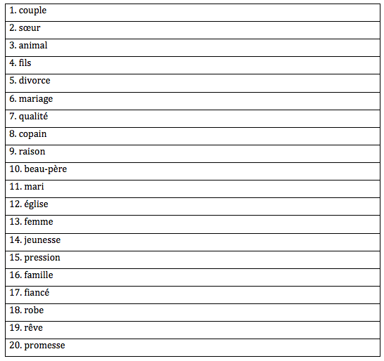
Listen to the nouns with their articles to correct or complete your work
Be careful: the words are not given in that order!
Tips
Listen out for ‘un’ or ‘une’ at the start
Pay good attention to the pronunciation of these nouns, you will have to use them later
Reminder:
Un: indefinite article for masculine nouns
Une: indefinite article for feminine nouns
Notes:
The audio file is embedded. You can play the passage directly from the slide when the PPT is set to full screen. The audio file is also available in the folder: ‘1Nouns’ ➔ Nouns-audio.mp3

Slide 9
Self-assessment: Genders
Answers
1. Un couple (m) | 11. Un mari (m)
2. Une sœur (f) | 12. Une église (f)
3. Un animal (m) | 13. Une femme (f)
4. Un fils (m) | 14. Une jeunesse (f)
5. Un divorce (m) | 15. Une pression (f)
6. Un mariage (m) | 16. Une famille (f)
7. Une qualité (f) | 17. Un fiancé (m)
8. Un copain (m) | 18. Une robe (f)
9. Une raison (f) | 19. Un rêve (m)
10. Un beau-père (m) | 20. Une promesse (f)
If you made an error:
Correct it in the table
Highlight it in the table
Re-write it in the ‘notes’ below the table
Mark your work:
Self-assessment:
Genders: /20

Slide 10
Nouns starting with a vowel
Using your table: check the gender of the two words below
église
animal
On your whiteboard:
-Write them both with their definite article
-Write them both with their indefinite article
What must be done? Why?
Reminder:
Definite article: le/ la
Indefinite article: un/une

Slide 11
Nouns starting with a vowel
Answers
From your table: check the gender of the two words below
église: une église, l’église
animal: un animal, l’animal
What must be done? Why?
le and la must be changed to l’
because the following noun starts with a vowel

Slide 12
Plurals
Reminder:
instead of le, la or l’➔ use les
instead of un or une ➔ use des
Nouns in French are usually made plural by adding an ‘s’ – same as English
e.g: la femme ➔ les femmes
BUT: Some nouns can’t be made plural by sticking an ‘s’ on the end!
They have irregular plural endings
Noun ending | Irregular plural ending | Example
-al -eau -eu -ou | -aux -eaux -eux -oux | le cheval ➔ les chevaux le bureau ➔ les bureaux le jeu ➔ les jeux le chou ➔ les choux
Note:
Nouns which already ends in -s, -x or -z don’t change in the plural form.
e.g: la souris ➔ les souris
Notes:
Students are given 30-60 seconds to read through the slide independently, before discussing as a whole class and check understanding

Slide 13
Let’s practise!
Write the singular form for these plurals:
Reminder:
le, la or l’➔ les
un or une ➔ des
les aînés (eldests)
des barbes (beards)
les beaux-pères (stepfathers)
des cheveux (hair)
des fils (sons)
les grands-parents (grandparents)
les grands-mères (grandmothers)
les morts (deaths)
les petites-filles (granddaughters)
des rapports (relationships)
les yeux (eyes)
Tips:
Make sure you check the article used for each of the nouns.
Also check if the nouns start with a vowel.
Then, think about the following:
Which noun does not change in the plural form? Why?
Which noun has an irregular plural ending?
Which noun has an irregular plural form?
What do you notice about compound nouns in the plural form?
Notes:
Mini whiteboards

Slide 14
Let’s practise!
Write the singular form for these plurals:
les aînés l’aîné
des barbes la barbe
les beaux-pères le beau-père
des cheveux un cheveu
des fils un fils
les grands-parents le grand-parent
les grands-mères la grand-mère
les morts la mort
les petites-filles la petite-fille
des rapports un rapport
les yeux un œil
Then, think about the following:
Which noun does not change in the plural form? Why?
un fils, because it already ends in -s
Which noun has an irregular plural ending? un cheveu
Which noun has an irregular plural form? un œil
What do you notice about compound nouns in the plural? Both parts must be put in the plural form
ALSO: The first part of the compound noun is put in the feminine form for les petites-filles
BUT not for les grands-mères ➔ exception!
Notes:
Mini white-board

Slide 15
Continue filling-in your table by writing the plural form of the nouns
Write them like in this example
Reminder:
Indefinite articles: un, une ➔ des
Definite articles: le, la, l’➔ les
For most nouns: add an –s
BUT…
Some nouns have irregular plural endings
(-al; -eau; -eu; -ou ➔ add –x)
Some nouns do not change
(m) ➔ des couples

Slide 16
Self-assessment: Genders
Answers
1. Un couple des couples | 11. Un mari des maris
2. Une sœur des sœurs | 12. Une église des églises
3. Un animal des animaux | 13. Une femme des femmes
4. Un fils des fils | 14. Une jeunesse des jeunesses
5. Un divorce des divorces | 15. Une pression des pressions
6. Un mariage des mariages | 16. Une famille des familles
7. Une qualité des qualités | 17. Un fiancé des fiancés
8. Un copain des copains | 18. Une robe des robes
9. Une raison des raisons | 19. Un rêve des rêves
10. Un beau-père des beaux-pères | 20. Une promesse des promesses
If you made an error:
Correct it in the table
Highlight it in the table
Re-write it in the ‘notes’ below the table
Mark your work:
Self-assessment:
Genders: /20
Plurals: /20

Slide 17
How good is your memory?
Hide the table so you can’t see the French words!
Here is the English translation for some of the keywords we have covered:
Which of these WERE NOT in the table?
Discuss in pairs and jot them down on your whiteboard
wedding | promise | nephew | partner
dream | youth | church | boyfriend
stepmother | son | trust | ring
aunt | twin | love | dress
reason | glasses | husband | engagement

Slide 18
How good is your memory?
Hide the table so you can’t see the French words!
Answers
wedding | promise | nephew | partner
dream | youth | church | boyfriend
stepmother | son | trust | ring
aunt | twin | love | dress
reason | glasses | husband | engagement
Don’t erase your whiteboard! We will use them again!

Slide 19
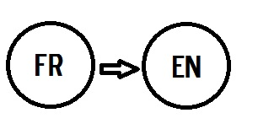
Continue filling-in your table by writing the English translation of the nouns
Write them like in this example
(m) ➔ des couples (couples)
Translate them from the plural form
Write them in brackets

Slide 20
Self-assessment: Translations
Answers
1. des couples (couples) | 11. des maris (husbands)
2. des sœurs (sisters) | 12. des églises (churches)
3. des animaux (pets/animals) | 13. des femmes (women)
4. des fils (sons) | 14. des jeunesses (youths)
5. des divorces (divorces) | 15. des pressions (pressures)
6. des mariages (weddings/ marriages) | 16. des familles (families)
7. des qualités (qualities) | 17. des fiancés (fiancés)
8. des copains (friends) | 18. des robes (dresses)
9. des raisons (reasons) | 19. des rêves (dreams)
10. des beaux-pères (stepfathers) | 20. des promesses (promises)
If you made an error:
Correct it in the table
Highlight it in the table
Re-write it in the ‘notes’ below the table
Mark your work:
Self-assessment:
Genders: /20
Plurals: /20
Translations: /20

Slide 21
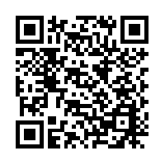
How did you do?
Independent study:
Whether or not you got full-marks, make sure you are off to a great start by reviewing and practising what we have covered today before your next lesson. Use this QR code to access the website:
Mark your work:
Self-assessment:
Genders: /20
Plurals: /20
Translations: /20
Total: /60
Practice makes perfect!
Notes:
Students can be encouraged to be independent learners from the start of the year with these QR codes for extra practice (should they need to improve further). These are for independent study only (i.e: cannot be checked by the teacher) and are not set homework. Website link: https://www.bbc.com/bitesize/guides/zjv9xyc (QR code is at the bottom of the worksheet)

Slide 22
Back to your whiteboard…
Write the letter corresponding to the French translation
stepmother
aunt
twin
glasses
nephew
trust
love
partner
boyfriend
ring
engagement
l’amour
la bague
la confiance
la tante
les fiançailles
le neveu
les lunettes
les jumeaux/ jumelles
le partenaire
la belle-mère
le petit-ami
1 | j
2
3
4
5
6
7
8
9
10
11

Slide 23
Back to your whiteboard…
Answers
1 | j
2 | d
3 | h
4 | g
5 | f
6 | c
7 | a
8 | i
9 | k
10 | b
11 | e
stepmother
aunt
twin
glasses
nephew
trust
love
partner
boyfriend
ring
engagement
l’amour
la bague
la confiance
la tante
les fiançailles
le neveu
les lunettes
les jumeaux/ jumelles
le partenaire
la belle-mère
le petit-ami

Slide 24
Let’s summarise and make notes
Nouns- Les noms
A noun is a naming word (a person, a thing or a place)
They are preceded by articles (the/a)
French nouns are either feminine or masculine
They are either singular (one) or plural (more than one)
 | the | a
masc. | le/ l’ | un
fem. | la / l’ | une
plur. | les | des
N.B.
Nouns ending in: -ien; -et; -isme; -ment; -eur; -age are often masculine
Nouns ending in: -euse; -esse; tude; trice; -lle; -sion; -tion are often feminine
We use l’ if the noun starts with a vowel (a, e, i, o, u)
In the plural form, we add an –s to the noun
In the plural form, we add an –x to the noun if it ends in : -al; -eau; -eu; -ou
Nouns which end in –s; -x; -z do not change in the plural form
Notes:
All Students can copy the top section of this summary in their book for their own record. Most able students can also write the N.B section

Slide 25
Objectives:
Knowledge: to define the terminology (nouns, articles, genders, singular, plural)
Transition
Nouns (articles, genders, plural)
Numbers 0-100 (age, dates,time)
Questions (open, closed)
Opinions (likes/ dislikes, reasons)
Comprehension: to identify genders of nouns
Application: to transform nouns from singular to plural form

Slide 26
Homework
Learn the 20 keywords from the table.
Make sure you know the gender and plural form too!
You will need them soon!

Slide 27
Objectives:
Knowledge: to be able to work out numbers when reading them
Transition
Nouns (articles, genders, plural)
Numbers 0-100 (age, dates, time)
Questions (open, closed)
Opinions (likes/ dislikes, reasons)
Comprehension: to understand numbers 1-60 in context
Application: to use numbers 1-100 in context and without support

Slide 28
French Numbers
How do French people count to a 100?
Let’s watch this video to get an idea
Notes:
Link: https://www.youtube.com/watch?v=vx2Ru0J6I9Q

Slide 29
Numbers from 1 to16
Read the speech bubbles and answer the questions on the worksheet
1. un | 9. neuf
2. deux | 10. dix
3. Trois | 11. onze
4. quatre | 12. douze
5. cinq | 13. treize
6. six | 14. quatorze
7. sept | 15. quinze
8. huit | 16. seize
Je m’appelle Claire et j’ai onze ans.
Moi c’est Charles.
J’ai huit ans.
Je me prénomme Sandra. Je viens d’avoir quatorze ans
Je m’appelle Mathilde. Je vais bientôt avoir treize ans.
Je suis Laurent et j’ai deux ans de plus que Sandra.
Notes:
The worksheet is available in folder: ‘2Numbers’ ➔ Numbers-WORKSHEET.pdf

Slide 30
Numbers from 1 to16
Answers
Je m’appelle Claire et j’ai onze ans.
Questions:
How old is Sandra ? 14
2. Who is 11 years old ? Claire
3. Who is the youngest person between Mathilde and Charles ? Charles
4. How old is Laurent ? 16
5. Rank the five people from the oldest to the youngest:
Laurent, Sandra, Mathilde, Claire, Charles
Moi c’est Charles.
J’ai huit ans.
Je me prénomme Sandra. Je viens d’avoir quatorze ans
Je m’appelle Mathilde. Je vais bientôt avoir treize ans.
Je suis Laurent et j’ai deux ans de plus que Sandra.
Correct your work if you made a mistake

Slide 31
Numbers 1-16: Let’s practise
Hide the number table to complete this activity from memory!
Choose your ability and give x in French
Je suis nul(le) en maths!
5 + 4 = x
25 ÷ 5 = x
c. 3 × 5 = x
13 – x = 6
e. 2x +1 = 9
Je suis bon(ne) en maths!
a. ( 3 + 2) × 2 = x
b. 3 + 2x = 27
c. x² -23 = 13
d. 5=2 + √x
Notes:
Extra practice on Mini whiteboard or draft paper

Slide 32
Numbers 1-16: Let’s practise
Answers
Je suis nul(le) en maths!
x = neuf
x = cinq
x = quinze
x = sept
e. x = quatre
Je suis bon(ne) en maths!
a. x = dix
b. x = douze
c. x = six
d. x = neuf

Slide 33
Numbers from 17 to 69
17. dix-sept | 22. vingt-deux
18. dix-huit | 30. trente
19. dix-neuf | 40. quarante
20. vingt | 50. cinquante
21. vingt et un | 60. soixante
Don’t forget the hyphen
Note: we don’t use and for the rest of the numbers
ten-seven
ten-eight
ten-nine
Reminder:
janvier
février
mars
avril
mai
juin
juillet
août
septembre
octobre
novembre
décembre
twenty and one
(same for:
31, 41, 51, 61)
Listen to these birthdays and complete the sentences 1-5
on the worksheet
Example: Mon anniversaire c’est le 7 mars
Notes:
The audio file is also available in the folder: ‘2Numbers’ ➔ birthdays-audio.mp3
Note: Some students might mention they came across 21,31,41 etc… written with hyphens (vingt-et-un). According to the 1990 spelling reform, these numbers should INDEED be written with hyphens. However, most textbooks, websites, videos and French people use the old spelling

Slide 34
Numbers from 17 to 69
Transcript
Now listen to the track again whilst reading the transcript,
then correct your work if necessary
Quelle est la date de ton anniversaire?
Example: Mon anniversaire c’est le sept mars
Mon anniversaire c’est le vingt septembre.
Mon anniversaire c’est le cinq juin.
Mon anniversaire c’est le vingt-deux janvier.
Mon anniversaire c’est le dix août.
Mon anniversaire c’est le douze octobre.
Extra: if you are finished early, answer the question by giving your own birthday

Slide 35
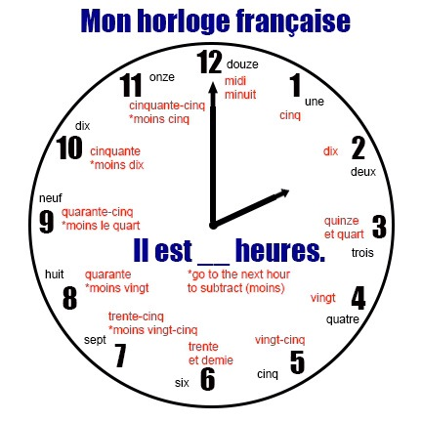
Giving the time
Write the time in English
Example: il est quatre heures ➔ it’s 4.00 am
Il est neuf heures quarante
Il est vingt-et-une heures trente
Il est dix-sept heures cinquante-cinq
Il est vingt-trois heures cinquante-huit
Il est six heures moins le quart
Il est midi et demie
Il est une heure et quart
Extra: Give the time in French
It’s 6 am
It’s 8.42 pm
It’s 1.25 pm
NOTE:
French people use both the 12 and 24 hour clock.
If they use the 12 hour clock, they specify with: du matin/ de l’après-midi/ du soir to avoid confusion.
Notes:
Extra practice on mini whiteboard or draft paper

Slide 36
Giving the time
Answers
Write the time in English
Example: il est quatre heures ➔ 4.00 am
Il est neuf heures quarante ➔ 9.40 am
Il est vingt-et-une heures trente ➔ 9.30 pm
Il est dix-sept heures cinquante-cinq ➔ 5.55 pm
Il est vingt-trois heures cinquante-huit ➔ 11.58 pm
Il est six heures moins le quart ➔ 5.45 am
Il est midi et demie ➔ 12.30
Il est une heure et quart ➔ 1.15 am
Extra: Give the time in French
It’s 6 am ➔ Il est six heures (du matin)
It’s 8.42 pm ➔ Il est vingt heures quarante-deux
It’s 1.25 pm ➔ Il est treize heures vingt-cinq
Notes:
Mini whiteboard or draft paper

Slide 37
Numbers from 70 to 100
70. soixante-dix | 60 + 10
71. soixante et onze | 60 + 11
72. soixante-douze | 60 + 12
80. quatre-vingts | 4 x 20
81. quatre-vingt-un | 4 x 20 +1
82. quatre-vingt-deux | 4 x 20 +2
90. quatre-vingt-dix | 4 x 20 + 10
91. quatre-vingt-onze | 4 x 20 + 11
99. quatre-vingt-dix-neuf | 4 x 20 + 10 + 9
100. cent
Note:
the ‘s’ at the end of vingt disappears
Also:
there is no ‘et’
(same for 91)

Slide 38
French phone numbers
You will hear two phone numbers to write down
Quel est le numéro de téléphone?
Exemple: 07 41 56 85 74
Premier numéro de téléphone:
Deuxième numéro de téléphone:
NOTE:
There are 10 digits per phone number
These are given in pairs
They start with:
01 (zéro un): in Île-de-France
02 (zéro deux): in the Northwest
03 (zéro trois): in the Northeast
04 (zéro quatre): in the Southwest
05 (zéro cinq): in the Southeast
Typical format: 07 41 56 85 74
Notes:
Note:
06 and 07 for mobile phones
08 for numbers which are free to call
09 for number via Internet provider

Slide 39
French phone numbers
Answers
Quel est le numéro de téléphone?
Premier numéro de téléphone:
01 26 48 14 72
Deuxième numéro de téléphone:
02 33 54 97 68
Correct your work if you made a mistake
Notes:
Audio file is also available in the folder: ‘2Numbers’➔ phone numbers-audio.mp3

Slide 40
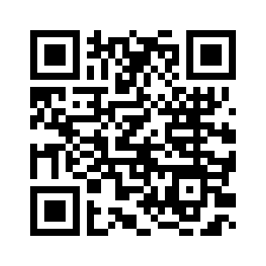
How did you do?
Independent study:
Numbers come up all the time in exams. You need to make sure you know them really well. You can also start looking at numbers above 100!
Use this QR code to access the website:
Numbers 1-16
Numbers 17- 69
Numbers 70- 100
Practice makes perfect!
Notes:
Website link: https://www.bbc.com/bitesize/guides/zgnthyc (QR code is at the bottom of the worksheet)

Slide 41
Objectives:
Knowledge: to be able to work out numbers when reading them
Transition
Nouns (articles, genders, plural)
Numbers 0-100 (age, dates, time)
Questions (open, closed)
Opinions (likes/ dislikes, reasons)
Comprehension: to understand numbers 1-60 in context
Application: to use numbers 1-100 in context and without support

Slide 42
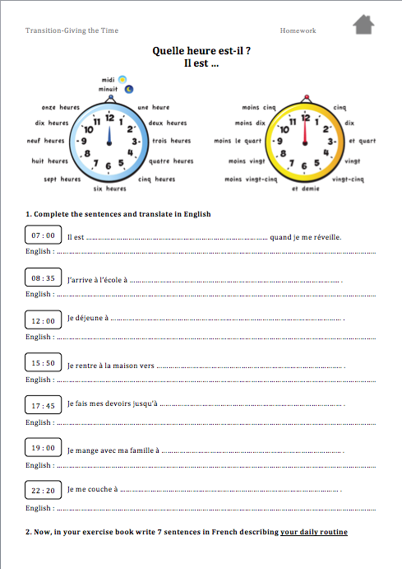
Homework
Complete the worksheet: Transition: Giving the time
Notes:
Worksheet is in the folder: ‘2Numbers➔ time-HOMEWORK.pdf

Slide 43
Objectives:
Knowledge: to form closed and open questions using your tone of voice
Transition
Nouns (articles, genders, plural)
Numbers 0-100 (age, dates, time)
Questions (open, closed)
Opinions (likes/ dislikes, reasons)
Comprehension: to understand closed and open questions in different registers
Application: to ask closed and open questions using different registers

Slide 44
Questions and Answers: Match-up
Comment tu t’appelles?
Quel âge as-tu?
Tu habites où?
Il y a combien de personnes dans ta famille?
Tu as un animal?
Quelle est ta couleur préférée?
Qu’est-ce que tu fais pendant ton temps libre?
Quelle est ta matière préférée?
Ma matière préférée est le français.
J’ai seize ans.
Dans ma famille, il y a trois personnes.
J’ai deux chiens.
J’habite à Paris en France.
Je m’appelle Coralie.
Pendant mon temps libre, je regarde la télévision.
Ma couleur préférée c’est le bleu
1 | 2 | 3 | 4 | 5 | 6 | 7 | 8
Notes:
Activity to complete on mini whiteboard or draft paper

Slide 45
Comment tu t’appelles?
Quel âge as-tu?
Tu habites où?
Il y a combien de personnes dans ta famille?
Tu as un animal?
Quelle est ta couleur préférée?
Qu’est-ce que tu fais pendant ton temps libre?
Quelle est ta matière préférée?
Ma matière préférée est le français.
J’ai seize ans.
Dans ma famille, il y a trois personnes.
J’ai deux chiens.
J’habite à Paris en France.
Je m’appelle Coralie.
Pendant mon temps libre, je regarde la télévision.
Ma couleur préférée c’est le bleu
Answers
1 | 2 | 3 | 4 | 5 | 6 | 7 | 8
f | b | e | c | d | h | g | a
In pairs and taking turns:
Ask each other these questions and give your own answers

Slide 46
Asking questions in French
Reminder:
There are two types of questions you can ask:
Questions which require a Yes/No answer (e.g: Do you like French?)
Questions which ask for specific information (e.g: where do you live?)
Let’s have a look at each type separately!
Note:
You will be required to ask a question in your speaking exam

Slide 47
Questions for Yes/No answers
There are three ways to ask this type of questions
1: Easiest way | 2: Formal way | 3: with ‘Est-ce que ’
Changing your tone of voice ➔ Say the normal sentence, but make your voice go up at the end. e.g: Tu aimes le français? Do you like French? (Literally: You like French?) | Put the verb first ➔ Swap the verb and the subject around. Don’t forget to add an hyphen. e.g: Aimes-tu le français? Note: If the verb ends in a vowel and is followed by il/elle/on, you need to add a ‘t’ to make it easier to say: e.g: Aime-t-il le français? | Add ‘Est-ce que’ at the start of your sentence + raise your voice e.g: Est-ce que tu aimes le français? Don’t forget to change que to qu’ if the next word is il/elle/on. e.g: Est-ce qu’il aime le français? Note: ‘Est-ce que’ replaces ‘Do/Does’ in English. (Do you like French?)

Slide 48
Let’s practise: Questions with Yes/No answers
Fill in the table on the worksheet
Note:
You might feel more confident using one way rather than another, but you need to know them all in case someone asks you a question differently!
Notes:
The worksheet is in the ‘3Questions’ folder: Questions-WORKSHEET.pdf
You can select: ‘Two pages per sheet’ to print on the same page

Slide 49
Let’s practise: Questions with Yes/No answers
Answers
Correct your work if you made a mistake
/8

Slide 50
Questions for specific answers
This type of questions requires a Question Word
Reminder:
Quand? When?
Pourquoi? Why?
Où? Where?
Qui? Who?
Comment? How?
Quoi? What?
Note: There are three ways to ask a question here too!

Slide 51
Questions for specific answers
1: Easiest way | 2: Formal way | 3: with ‘Est-ce que ’
Changing your tone of voice + Question Word at the end e.g: Tu habites où? Where do you live? (Literally: You live where?) | Put the Question Word first then swap verb and subject e.g: Où habites-tu? | Question Word first then ‘est-ce que’ e.g: Où est-ce que tu habites? Note: ‘est-ce que’ still replaces the ‘do/does’ (Where do you live?)
Be careful! There are a few exceptions!
Pourquoi is the only Question Word which needs to be placed at the start! e.g: Pourquoi tu aimes le français? | Quoi becomes: Que e.g: Que fais tu le week-end? | Quoi + est-ce que becomes: Qu’est-ce que e.g: Qu’est-ce que tu fais le week-end?

Slide 52
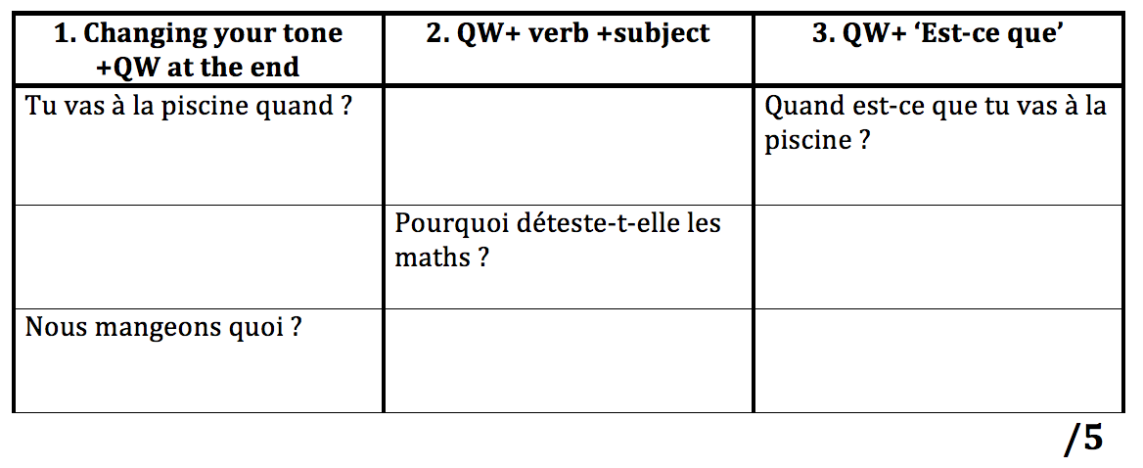
Let’s practise: Questions for specific answers
Fill in the table on the worksheet
TIP:
Don’t forget to add a ‘t’ or change que to qu’ when necessary
Look out for exceptions

Slide 53
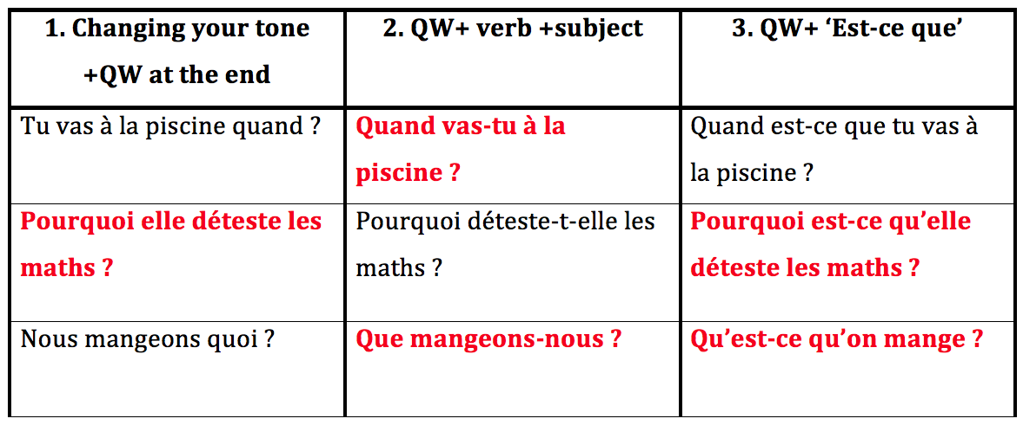
Let’s practise: Questions for specific answers
Answers
Correct your work if you made a mistake

Slide 54
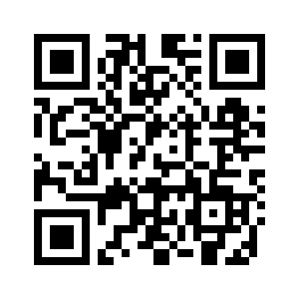
How did you do?
Independent study:
You probably feel you need more practice. Don’t worry, that’s normal! Just make sure you review this grammar point independently.
Use this QR code to access the website:
Questions for Yes/No answers: /8
Questions for specific answers: /5
Total: /13
Practice makes perfect!
Notes:
Website link: https://www.bbc.com/bitesize/guides/z389kqt (QR code is at the bottom of the worksheet)

Slide 55
Objectives:
Knowledge: to form closed and open questions using your tone of voice
Transition
Nouns (articles, genders, plural)
Numbers 0-100 (age, dates, time)
Questions (open, closed)
Opinions (likes/ dislikes, reasons)
Comprehension: to understand closed and open questions in different registers
Application: to ask closed and open questions using different registers

Slide 56
Homework- Using the polite form
Research when to use « tu » and when to use « vous » in French and summarise the information in a table or a diagram.
(Don’t go overboard! Half a page is enough.)
Tip:
To get you started, type ‘tu or vous’ in Youtube

Slide 57
Objectives:
Knowledge: to recognise a range of expressions of opinions
Transition
Nouns (articles, genders, plural)
Numbers 0-100 (age, dates,time)
Questions (open, closed)
Opinions (likes/ dislikes, reasons)
Comprehension: to pick up information about other people’s opinions
Application: to use a range of expressions when giving opinions and provide justifications

Slide 58
Expressions to give opinions
Scan the text and find expressions giving opinions
Je trouve ma famille vraiment super. J’adore mes parents et je pense que mon frère est intéressant. En particulier, J’aime être avec ma mère. À mon avis elle est patiente et gentille. Je crois que l’activité que je préfère faire avec ma famille, c’est aller au restaurant. Ça me plaît beaucoup car je m’intéresse à la cuisine. Personnellement, j’aimerais passer plus de temps avec mon père. Il travaille beaucoup et je déteste ça!
Tip: Don’t be put off by words you don’t know. There are 12 expressions, 4 of which you have used since year 7!
Note: Giving opinions is a great way to pick up marks in the exam.
Notes:
Give students a minute to scan the text then discuss as a whole class

Slide 59
Expressions to give opinions
Answers
How many did you manage to find?
Je trouve ma famille vraiment super. J’adore mes parents et je pense que mon frère est intéressant. En particulier, J’aime être avec ma mère. À mon avis elle est patiente et gentille. Je crois que l’activité que je préfère faire avec ma famille, c’est aller au restaurant. Ça me plaît beaucoup car je m’intéresse à la cuisine. Personnellement, j’aimerais passer plus de temps avec mon père. Il travaille beaucoup et je déteste ça!

Slide 60
Likes and Dislikes
Translate these expressions on your worksheet
J’adore J’aime Je préfère Ça me plaît Je m’intéresse à | Je déteste Je n’aime pas Je ne préfère pas Ça ne me plaît pas Je ne m’intéresse pas à
Note: J’aime can mean I like or I love
➔ J’aime Caroline means I love Caroline. If you wish to say I like Caroline, you need to use: J’aime bien Caroline.
Notes:
The worksheet is in the folder: ‘4Opinions’ ➔ Opinions-WORKSHEET.pdf

Slide 61
Likes and Dislikes
Answers
J’adore I love J’aime I like/ I love Je préfère I prefer Ça me plaît I like it (literally: it pleases me) Je m’intéresse à I am interested in | Je déteste I hate Je n’aime pas I don’t like Je ne préfère pas I don’t prefer/ I prefer not to… Ça ne me plaît pas I don’t like it Je ne m’intéresse pas à I am not interested in

Slide 62
Saying what you think
There are other expressions you can use to give your points of view
Personnellement (Personally)
À mon avis (In my opinion)
Je pense que (I think that)
Je crois que (I believe that)
Je trouve que (I find that)
Je trouve… +adjectif (I find ...+adjective)
Il me semble que (It seems to me that)
... me semble +adjectif (...seems +adjective to me)
...me paraît +adjectif (...appears +adjective to me)
Tip:
Read through these expressions carefully. They are very useful to give points of view, whether they are positive or negative.
Notes:
Students are given a minute to read through these expressions

Slide 63
Listening practice: Positive or Negative?
You will listen to two passages: one about television and one about gardening.
Record if the opinion given by each of the four people is positive (P) or negative (N).
La télévision | Le jardinage
a. b. c. d. | a. b. c. d.
Tip: Scribble down the keywords you hear that give you clues
/8
Notes:
Audio files can also be found in the folder: ‘4Opinions’.

Slide 64
Listening practice: Positive or Negative?
Use the transcripts to correct your work
La télévision | Le jardinage
a. J’aime beaucoup regarder la télé. C’est super. b. Je déteste regarder la télé. C’est nul. c. Je n’aime pas regarder la télé. C’est très ennuyeux. d. La télé? C’est mon passe-temps préféré. | a. Je passe des heures et des heures dans mon jardin. Ça me plaît et j’ai une passion pour les fleurs. b. J’aide mon père toutes les semaines dans le jardin. Ça me fait grand plaisir. c. Le jardinage, c’est très fatigant. Ça me fait mal au dos. d. Je m’intéresse beaucoup au jardinage. Cette année je vais cultiver des légumes et je trouve ça extra.

Slide 65
Listening practice: Positive or Negative?
Answers
La télévision | Le jardinage
a. J’aime beaucoup regarder la télé. C’est super. P b. Je déteste regarder la télé. C’est nul. N c. Je n’aime pas regarder la télé. C’est très ennuyeux. N d. La télé? C’est mon passe-temps préféré. P | a. Je passe des heures et des heures dans mon jardin. Ça me plaît et j’ai une passion pour les fleurs. P b. J’aide mon père toutes les semaines dans le jardin. Ça me fait grand plaisir. P c. Le jardinage, c’est très fatigant. Ça me fait mal au dos. N d. Je m’intéresse beaucoup au jardinage. Cette année je vais cultiver des légumes et je trouve ça extra. P

Slide 66
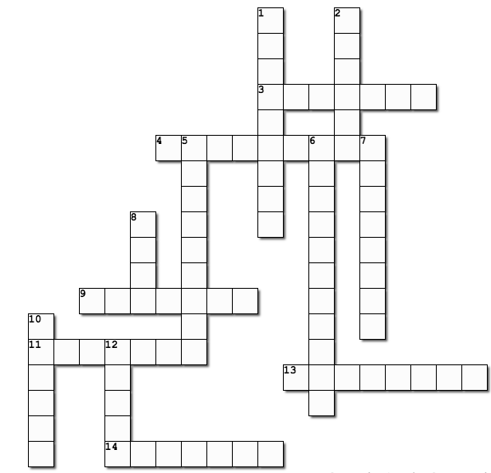
Reasons for your opinion
Check the clues on the worksheet: Across and Down Complete the crossword with the French equivalent
Reminder:
affreux
amusant
beau
compliqué
difficile
énervant
ennuyeux
facile
génial
important
intéressant
mauvais
patient
sympa
Note:
Using describing words to explain your opinions will get you extra marks!

Slide 67
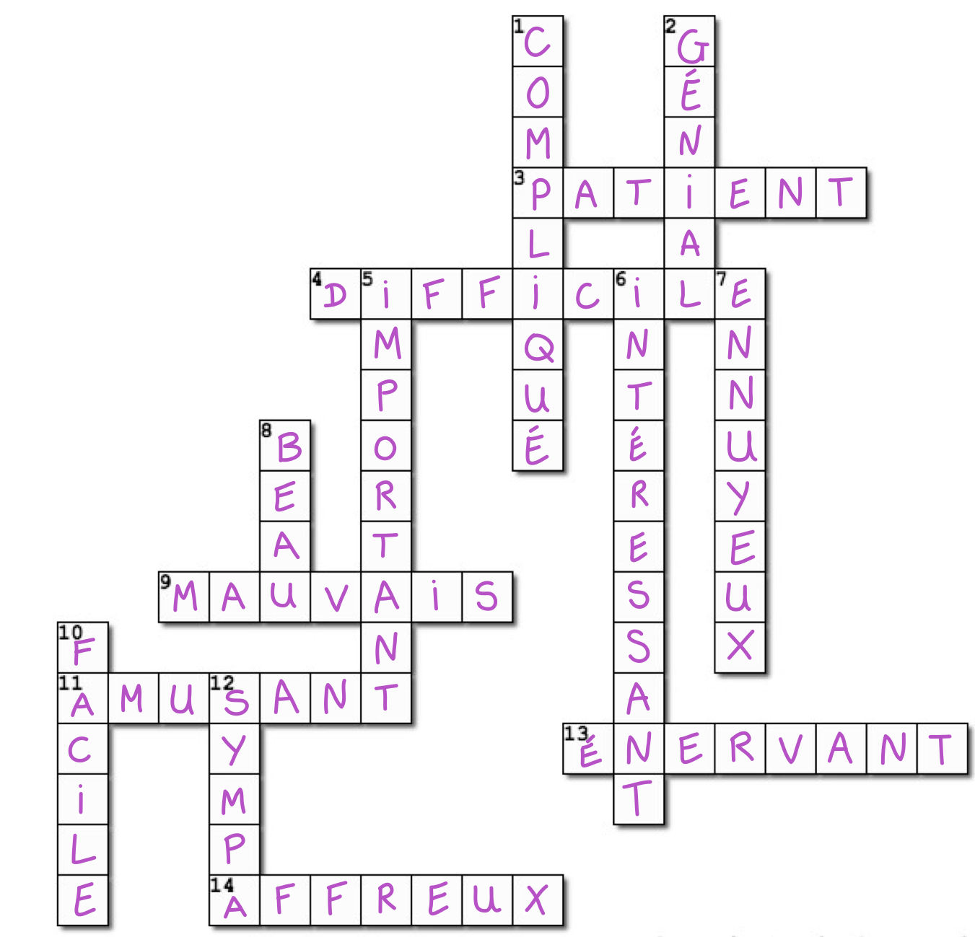
Answers

Slide 68
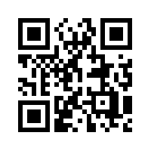
How did you do?
Independent study:
You will need to express your opinions and justify them in all the units that will be covered at GCSE, so make sure you can use a cracking variety!
Use this QR code to access the website:
Likes and Dislikes
Positive and Negative opinions
Reasons for your opinion
Practice makes perfect!
Notes:
Website link: https://www.bbc.com/bitesize/guides/zwcbgk7 (QR code is at the bottom of the worksheet)

Slide 69
Objectives:
Knowledge: to recognise a range of expressions of opinions
Transition
Nouns (articles, genders, plural)
Numbers 0-100 (age, dates,time)
Questions (open, closed)
Opinions (likes/ dislikes, reasons)
Comprehension: to pick up information about other people’s opinions
Application: to use a range of expressions when giving opinions and provide justifications

Slide 70
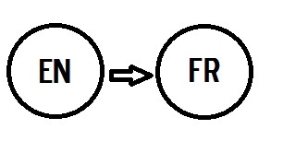
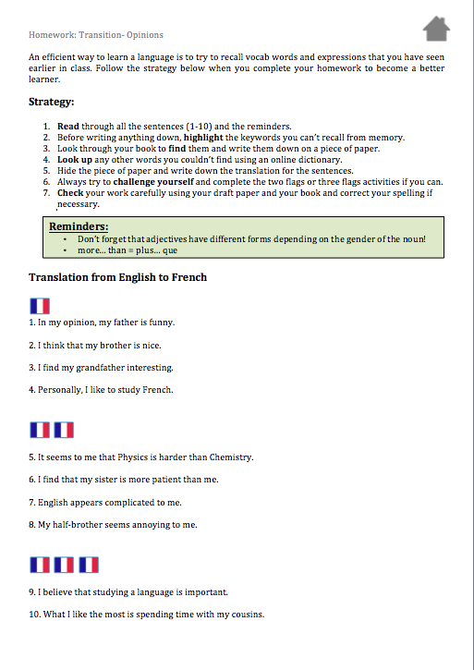
Homework: Translation En-Fr
Complete the worksheet: Transition: Opinions
Notes:
Worksheet is in the folder: ‘4Opinions’ ➔ opinions-HOMEWORK.pdf

