Slide 1
GCSE Options Evening for Year 9 2024/2025

Slide 2
Ms Bernardino Head of Performing & Creative Arts
r.bernardino@kps.co.uk

Slide 3
Music
AQA 8271
Core information
Content
Component 1 - 40% | Component 2 - 30% | Component 3 - 30%
Listening exam: Unfamiliar music and study pieces | Performance 1: solo performance | Composition 1: composition to a brief
 | Performance 2: ensemble performance | Composition 2: free composition
Course requirements:
Grade 4 standard or equivalent in any instrument/voice by September 2025
Prior knowledge of music theory
Regular participation in music events, such as half-termly concerts and internal & external competitions
Why Music?
Performing and watching concerts in and out of school, workshops by industry professionals, composing and performing competitions in and out of school.
Employers and universities are increasingly looking for young people who have skills that are learned through creative subjects, including creative thinking, emotional intelligence, adaptability, communication, teamwork and more.
Contrary to popular belief, studying music opens doors far beyond a career in performance: sound technician, musical director, music therapist, events, film, broadcasting, publishing, producing and editing are just some of the many paths you may take.

Slide 4
Ms McQuillan Teacher of Drama S.McQuillan@kps.co.uk

Slide 5
Drama
AQA 8261
Core information
Content
Component 1 | Component 2 | Component 3
Written Exam 1 hour 45 minutes | Devising | Scripted Exam
Theatre terms & roles in the theatre 4 questions on a set text Live theatre evaluation on a play we watch together | Students must create a 20-minute piece, inspired by a given stimulus (open to an audience) Students must also complete coursework detailing the process of creating this | Students perform two short performances from a script Performed in front of a live audience with an external examiner
Develop skills in:
Public Speaking
Social skills/understanding others
Teamwork
Observation/evaluation/ analysis
Independent study and time management
Creativity
Performance skills
Confidence
Course requirements:
Attend two-three compulsory Sunday rehearsals over the course
Attend all evening theatre trips (usually one a term)
Complete all coursework/learn lines by deadlines: this needs to be done independently at home
Be passionate about the subject and work well with others to create a safe learning environment
After-school rehearsals and evening rehearsals
Interventions/coursework assistance will be held outside of lessons

Slide 6
Ms Akinci Teacher of Art s.akinci@kps.co.uk

Slide 7
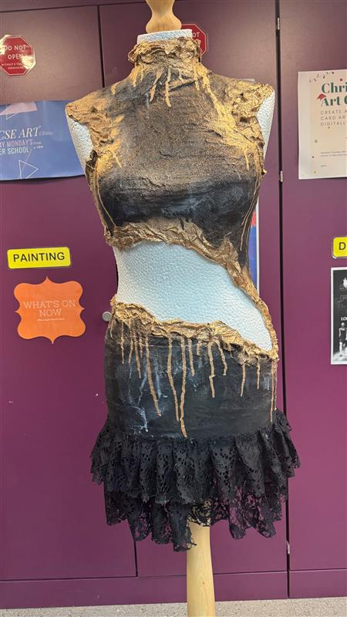
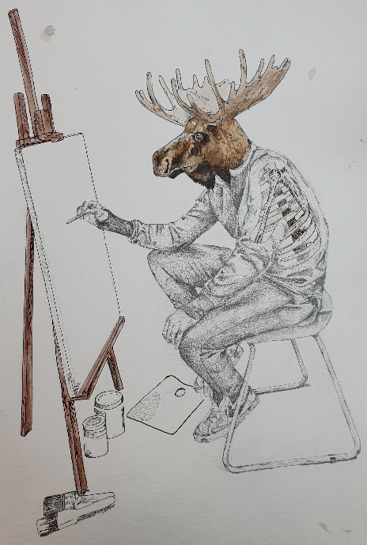
Art and Design
AQA 8201
Core information
Content​
AO1:​ Contextual understanding (25%) | AO2​: Creative making (25%) | AO3​: Reflective recording (25%) | AO4: Personal presentation (25%)
Develop ideas through investigations, demonstrating critical understanding of sources. | Refine work by exploring ideas, selecting and experimenting with appropriate media, materials, techniques and processes. | Record ideas, observations and insights relevant to intentions as work progresses. | Present a personal and meaningful response that realises intentions and demonstrates understanding of visual language.
Course requirements:
Current Year 9 Art students
Minimum GCSE preparedness grade: Expected
Afterschool Art Clubs are weekly and compulsory
Minimum expected hours spent outside of lessons 4-6 hours
Non Y9 Art students must see Miss Akinci with a portfolio if there's an interest!
Component 1: Coursework Portfolio (60%) Every lesson and prep work counts towards their actual GCSE grade. This is a sustained project, responding to a theme set by the school which evidences the journey from initial engagement to the realisation of intentions. As well as practical work, this portfolio must demonstrate the research and critical study of artists which connect with the chosen area of study.
Component 2: Exam (40%) This is a shorter project, where students respond to starting point from an externally set paper. A preparatory period is then followed by 10 hours of supervised time in which to create a final outcome.
GCSE Art provides students a chance to develop and nurture this life affirming activity, both visually and conceptually, developing their own unique approach to the visual arts with the support of their teacher. Students will learn from direct teaching, peer learning, presentations, gallery trips, reflective reading and writing as well as visits from professional practitioners working in the creative sectors. All art students are encouraged to experiment and will have the opportunity to use a wide range of materials including, but not limited to, painting, drawing, sculpture, video, installation, photography, performance and printmaking. Art and Design leads to a range of job opportunities within the creative sector from graphic designers, architects, engineers, product designers and marketing etc.

Slide 8
Dr. Maroon Head of Science h.maroon@kps.co.uk

Slide 9
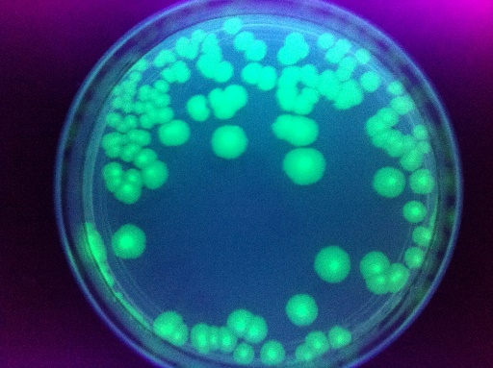
Biology
IGCSE (Edexcel 4Bi1)
Core information
In Year 9 students study: Cells, respiration, plants, blood and circulatory system
Students start the GCSE course in Year 9 and study 5 large topics throughout the three year GCSE course
Careers: Elite sports coach, medical doctor, radiotherapist, NHS clinical scientist, forensic scientist, physiotherapist, vet, nutritionist, dentist and pharmacist.
Skills: Eye for detail, being observant and the ability to evaluate written and numerical evidence from various sources in order to make well-informed and balanced decisions.
Science Club and SciArt Club
Most of the year study Biology at GCSE

Slide 10
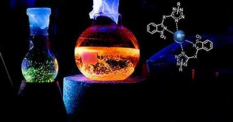
Chemistry
IGCSE (Edexcel 4Ch1)
Core information
In Year 9 students study: States of matter, Periodic Table, Chemical formulae
Students start the GCSE course in Year 9 and study 4 large topics throughout the three year GCSE course
Careers: Analytical chemist, Biotechnologist, Chemical engineer, Clinical biochemist, Forensic scientist, Laboratory technician, Nanotechnologist, Pharmacologist, Policy analyst, Process chemist
Skills: Critical thinking, Problem solving, Analysis, Reasoning, Interpretation, Decision making, communication, collaboration, teamwork
Science Club and SciArt Club
Most of the year study Chemistry at GCSE

Slide 11
Physics
IGCSE (Edexcel 4Ph1)
Core information
In Year 9 students study: Energy, Waves and Magnetism
Students start the GCSE course in Year 9 and study 8 topics throughout the three year GCSE course
Careers: Astronaut, Astronomer, Medical Physicist, Structural engineer, Mechanical Engineer, Civil Engineer, Electrical Engineer, Physicist
Indirect careers: Medic, Lawyer, Business development manager, Data scientist, Management consultant, Architect, Video game designer
Skills: Critical thinking, Data analysis, Time management, Teamwork, Problem-solving, Computing, Communication, Numeracy, Research skills
Science Club and SciArt Club
Most of the year study Physics at GCSE

Slide 12
Science Examination
IGCSE (Edexcel) Assessment:
Core information
End of year 11, there are 2 exams per subject.
For Triple Award Science:
Biology= 2 papers
Chemistry= 2 papers
Physics= 2 papers
Total number of examinations taken: 6
For Double Award Science
Biology= 1 paper
Chemistry= 1 paper
Physics= 1 paper
Total number of examinations taken: 3
Assessment Overview
Paper 1: Written paper: 2 hours 61.1% of total GCSE 110
Paper 2: Written paper: 1 hour and 15 minutes 38.9% of total GCSE 70 marks

Slide 13
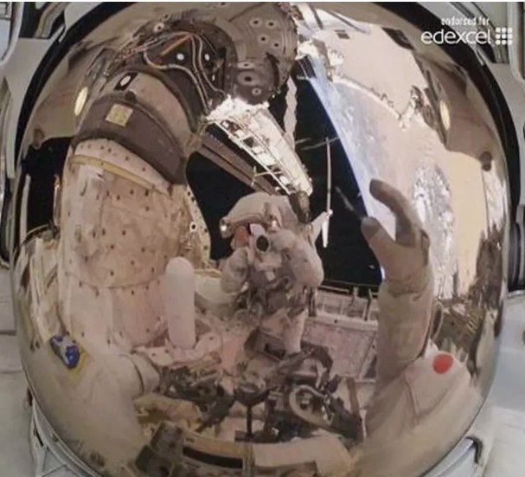
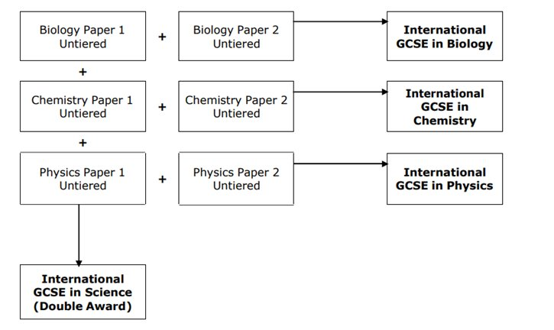
Double Award Science
IGCSE (Edexcel)
Core information

Slide 14
Dr Stewart Head of English L.Stewart@kps.co.uk

Slide 15
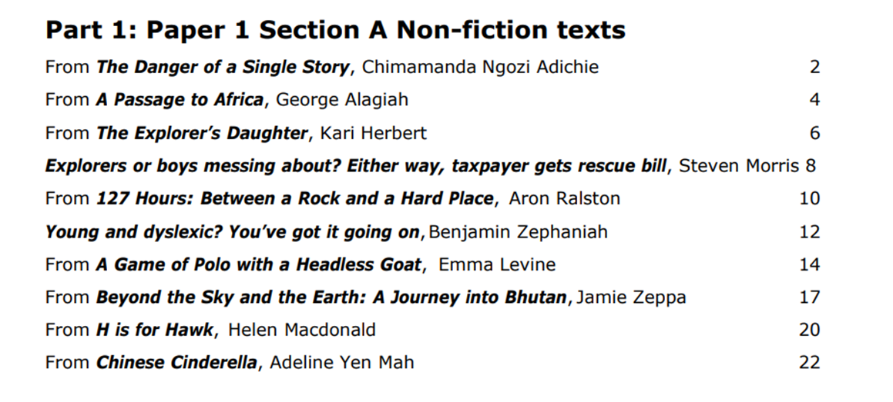
IGCSE Edexcel
English Language Paper 1 60%
Non-Fiction reading extracts (seen from the Anthology and Unseen) Part 1
Transactional writing

Slide 16
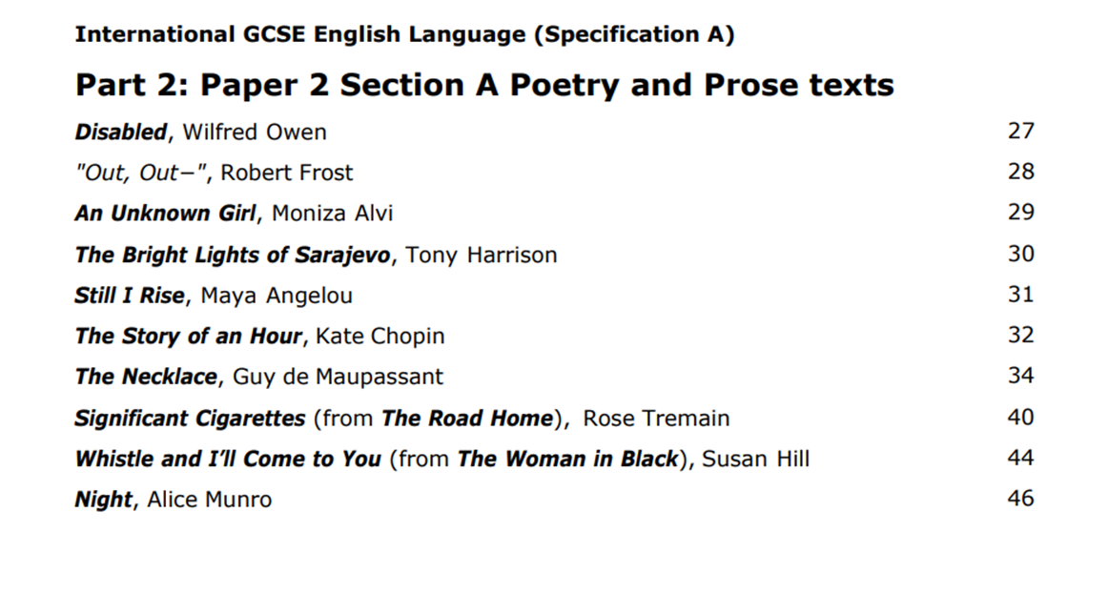
IGCSE Edexcel
English Language Paper 2 40%
Poetry and Prose (Part 3)
Imaginative writing

Slide 17
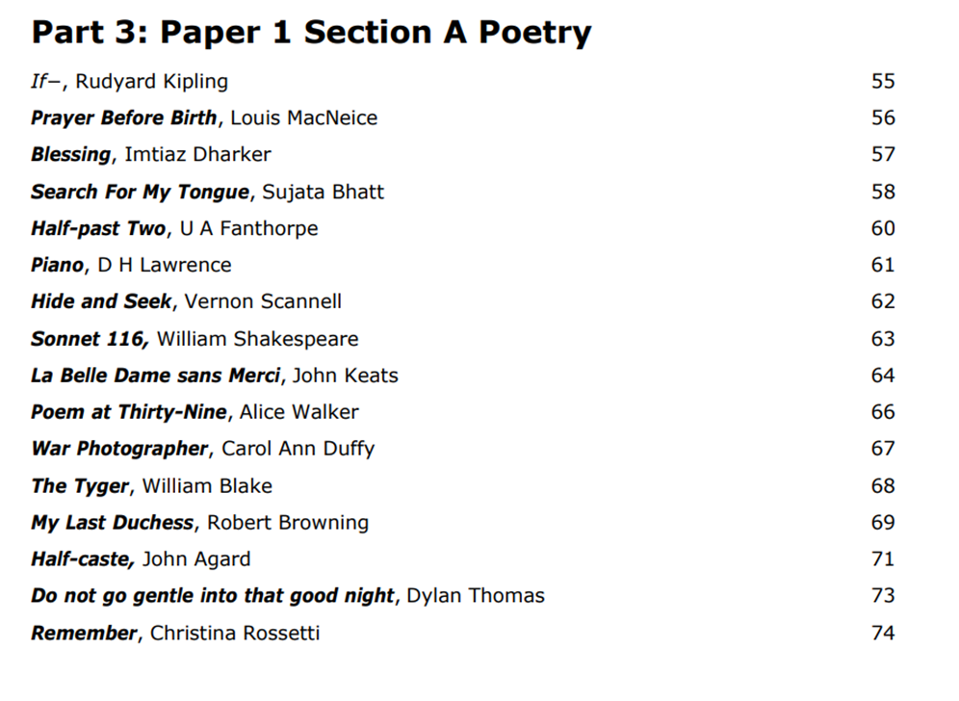
IGCSE Edexcel
English Literature Paper 1 60%
Poetry and Modern Prose
Unseen Poetry
2. Comparative Poetry (part 3 from the anthology)
3. Of Mice and Men

Slide 18
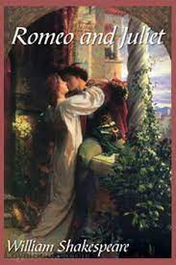
IGCSE Edexcel
English Literature Paper 2 40%
Modern Drama and Literary Heritage Texts
•An Inspector Calls
•Romeo and Juliet

Slide 19
Ms Kaur Teacher of Computer Science j.kaur@kps.co.uk

Slide 20
Computer Science
OCR J277
Possible University Courses and Careers:
Software Engineering
IT and Cyber Security
Accountancy
Animation
Art & design
Business Studies
Communication
Computing
Digital Media
Education
Engineering
Finance
Gaming
Marketing
Media
Medicine
Robotic
Science
Technology
Many more……
Content Overview | Assessment Overview
Component 1 Computer Systems | Written paper: 1 hour and 30 minutes 50% of total GCSE 80 marks
Component 2 Computational thinking, algorithms and programming | Written paper: 1 hour and 30 minutes 50% of total GCSE 80 marks
This exciting GCSE gives students an excellent opportunity to investigate how computers work and how they’re used, and to develop computer programming and problem-solving skills. They’ll also do some fascinating in-depth research and practical work.
Co-curricular opportunities: Coding (Python) club, Robotics club, a trip to Bletchley Park, day trips to science museums..
Computers are changing every part of our lives at an ever increasing rate – why not drive the future?

Slide 21
Mr Lacasa Inglada Teacher of Spanish Head of Languages a.lacasa@kps.co.uk

Slide 22
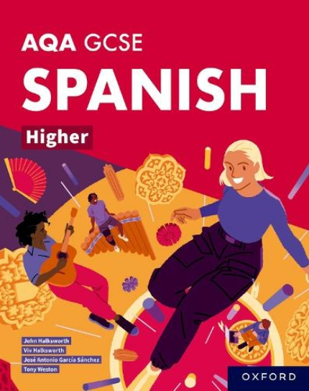
Spanish - AQA 8692
8 Reasons to Choose a Language at GCSE and A level | School Guide Blog
Core information
Content
Theme 1 People and lifestyle | Theme 2 Popular culture | Theme 3 Communication and the world around us
Topic 1:Identity and relationships with others | Topic 1: Free-time activities | Topic 1: Travel and tourism, including places of interest
Topic 2: Healthy living and lifestyle | Topic 2: Customs, festivals and celebrations | Topic 2: Media and technology
Topic 3: Education and work | Topic 3: Celebrity culture | Topic 3: The environment and where people live
Four Papers: Listening (25%), Reading (25%), Speaking (25%) and Writing (25%).
Extra-curricular opportunities: local trips to the theatre, cinema and cultural events to gain further knowledge of the Hispanic language and the culture.
Where does your GCSE subject take the student in the future?: In this global, digital age, the ability to be able to share information and communicate with a variety of audiences around the world is extremely powerful. Speaking an additional language is a useful skill in many industries and sectors: journalism, media and communication, finance, law, translation, teaching, High Tech sector, film and TV industry, translation, politics and many more. Spanish is the official language in 21 countries in the world.

Slide 23
Ms Fuld Teacher of French l.fuld@kps.co.uk

Slide 24
French - AQA - 8692
Core information
Content
Theme 1 People and lifestyle | Theme 2 Popular culture | Theme 3 Communication and the world around us
Topic 1:Identity and relationships with others | Topic 1: Free-time activities | Topic 1: Travel and tourism, including places of interest
Topic 2: Healthy living and lifestyle | Topic 2: Customs, festivals and celebrations | Topic 2: Media and technology
Topic 3: Education and work | Topic 3: Celebrity culture | Topic 3: The environment and where people live
8 Reasons to Choose a Language at GCSE and A level | School Guide Blog
Four Papers: Listening (25%), Reading (25%), Speaking (25%) and Writing (25%).
Extra-curricular opportunities: enjoy the culture and practise the language by visiting the French institute, day trips to museums, and much more!
Where does your GCSE subject take the student in the future? Speaking an additional language is a useful skill in many industries and sectors: journalism, media and communication, finance, translation, teaching and much more. 29 countries in the world have French as their official language. Think about where it could take you!

Slide 25
Ms Lu Teacher of Mandarin c.lu@kps.co.uk

Slide 26
Mandarin AQA GCSE - 8673
Core information
Content​
Theme 1: Identity and culture | Theme 2​: Local, national, international and global | Theme 3​: study and employment
Me, my family and friends | Home, town and region​ | My studies​
Technology in everyday life | Social issues​ | Life at school​
Free-time activities | Global issues​ | Education post-16​
Customs and festivals​ | Travel and tourism​ | Jobs and careers​
8 Reasons to Choose a Language at GCSE and A level | School Guide Blog
Why Mandarin?​
We offer trips to China/ East Asia during the school holidays if there is a viable number of participants. There are also places within London we will visit during school days. We have established partner schools in Taiwan to have online exchange for our students. We celebrate Chinese New Year every year with culture-enriched workshops and events.​
Mandarin Chinese is the most widely spoken language in the world and is seen as important for young people in the UK to master in order for the country to remain globally competitive in the future. ​
Young people with an understanding of China and of the language will be better prepared for the international workplace and the society of the future.

Slide 27
Ms Kazani
Teacher of Classical Civilisation and Latin
R.Kazani@kps.co.uk

Slide 28
Latin OCR J282
Core information
From OCR:
Our GCSE in Latin is designed to help students develop their knowledge and understanding of the vocabulary, syntax and accidence of the Latin language, and also of ancient literature, values and society through the study of original texts.
Students will study the Latin language and Literature from Oxford and Cambridge Anthology and Classical texts, such as 'the Aeneid'
There will be three examinations (Latin language, Literature Prose, and Literature Verse.
Why Latin?
There will be trips around the UK, and hopefully also to Italy and Greece.
Learning Latin Grammar and Syntax help students to understand both English and other languages better.
The texts enable the students to learn about the history and culture of ancient Rome. There are also lots of opportunities for analysing literature, like in English.
As with classical civilisation, Latin also complements humanities subjects. Additionally, Latin develops key logic skills, making it a great option for study alongside mathematics or science.

Slide 29
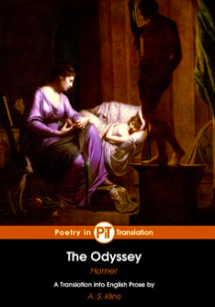
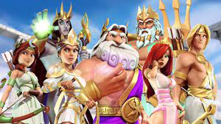
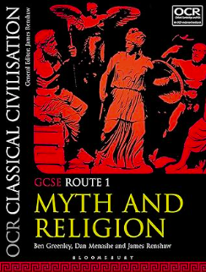
Classical Civilisation
OCR J199
Core information
From OCR:
Our GCSE in Classical Civilisation provides students with a broad, coherent and rewarding study of the culture of the classical world. They study elements of the literature and visual/material culture of Greece and Rome and develop an understanding of their social, historical and cultural contexts.
2 modules: 'Myth and Religion' (covered in Year 10) and 'The Homeric World' (covered in Year 11).
2 exams, 1 for each of the two modules.
Why Classical Civilisation?
There will be trips around the UK, and hopefully also to Italy and Greece.
There will be plenty of opportunities for writing, connecting the subject with English literature. Students will also analyse historical artefacts, as well as learning about ancient practices and culture, much like in history. They will start creating strong arguments and developing their critical analysis,
The subject provides an excellent basis for studying any humanities subject at sixth form, especially Latin, Greek, English, history, or classical civilisation.
With a lot of Myths, Heroes, and Adventure!

Slide 30
Ms Behaghel Teacher of History C.Behaghel@kps.co.uk

Slide 31
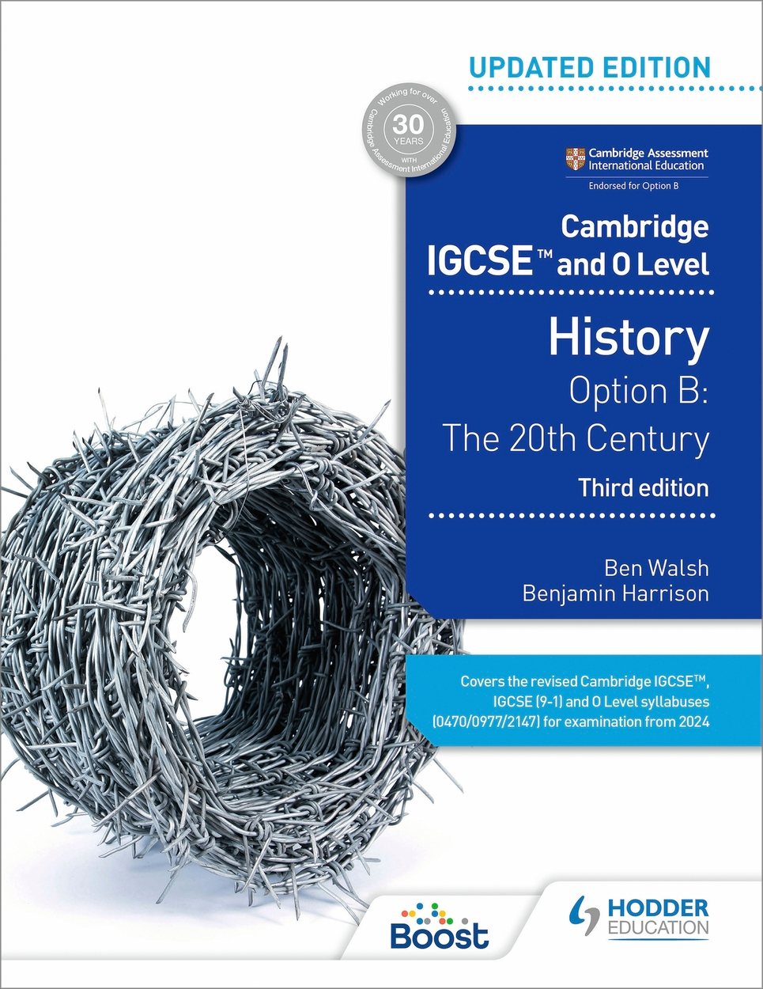
History
CIE iGCSE 0977
What do we study?
Core Content
The Twentieth Century: International relations since 1919
Depth Study:
Germany, 1918-1945
Why should I pick History?
Diversity in what we study.
Fascinating insight into political, social and economic issues of the past.
Learn a range of useful skills e.g. analytical, problem solving and creative thinking.
Brilliant trip opportunities!

Slide 32
Miss Phillips Teacher of Geography s.phillips@kps.co.uk

Slide 33
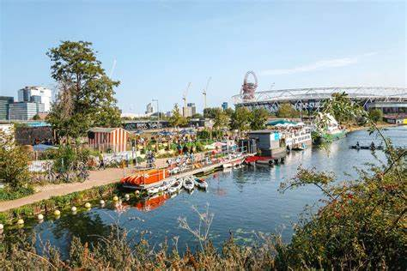
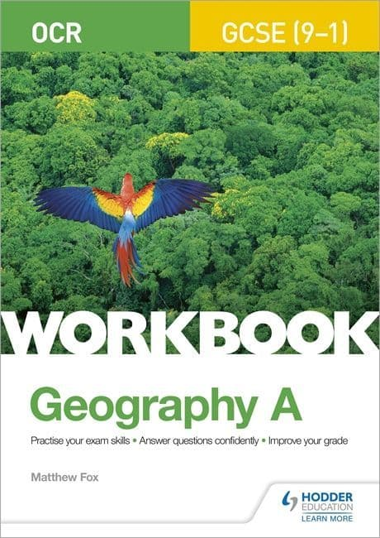
Geography
OCR A J383
What do we study?
Human
Physical
Environmental
Fieldwork (fieldtrips included!)
From a UK and Global Perspective
Currently we look at river environments and urban landscapes for out fieldtrips.
Why should I pick Geography?
Discussion based
Contemporary studies
Diverse topics
Encourages empathy and understanding of other places and current issues
If you enjoy it!

Slide 34
Mr Travers Teacher of Religious Studies m.travers@kps.co.uk

Slide 35
Religious Studies
AQA 8062
What do we study?
Christianity
Islam
Philosophy – The problem of evil, arguments for the existence of God
Ethical issues including; euthanasia, abortion, capital punishment
Why should I pick RS?
Lots of chances for group discussion
Develop your ability to be critical (and argue!)
Explore contemporary religious and ethical issues
Your opinion matters

Slide 36
Mr Rider Director of Sport S.Rider@kps.co.uk

Slide 37
It is so much more than just kicking or throwing a ball. Studying PE will help you learn how to best communicate with people in a team in order to produce the best results.
- Current Year 11 Student
Physical Education
AQA 8582
Paper 1: ​ ​The human body and movement in physical activity and sport. ​ | 30%​ | 1 Hour 15-minute written paper​ 78 marks​
Paper 2: ​ ​Socio-cultural influences and wellbeing in physical activity and sport.​ | 30%​ | 1 Hour 15-minute written paper​ 78 marks​
Practical Assessment: ​ ​Practical performance in physical activity and sport (75 marks) Analysis and evaluation of performance to bring about improvement in activity. (25 marks) | 40% ​ ​​ | 100 Marks​ ​Internal Assessment External Moderation.​
Extra-curricular Opportunities: day trips, museums, specialist workshops, dissection practicals, special guest lectures, live sport events, practical training sessions and much more!
GCSE Physical Education and the future: Studying GCSE Physical Education allows you to develop a wider interest in the human body, both physiologically and psychologically. Students can use their understanding of Physical Education in a variety of industries such as business, education, coaching, journalism, medical care and more…

Slide 38
Mr Peter Brazier Head of Social Sciences p.brazier@kps.co.uk

Slide 39
Business
1BS0
Core information
Investigating small business and building a business.
Thorough course covering the main sections of skills and attitudes in preparation for both secondary education and also work beyond.
Business enables student to access a wide array of financial, organisational and business-related skills.
Business is the first main subject which enables students a look into what work will be like after they finish school, get a sense of the decision making of everyday business and the opportunity to develop a knowledge a new subject previously not studied.
Trips, talks and business-related tasks and challenges – the subject has a huge range of growing opportunities that students have never experienced before in school.
Increasingly popular at the lower school – business has some of the bigger classes of option subjects at GCSE and at A-level.

Slide 40
Year 9 Options Evening
Presented by Gaurav Sharma
Head of Maths & Computing, KS5 Academic Lead, Timetabler

Slide 41
Year 9 → Year 10 Options
GCSE JOURNEY (9)
Maths
English Language
English Literature
Double Science Award x 2
OPTION A
OPTION B
OPTION C
OPTION D
GCSE JOURNEY (10)
Maths
English Language
English Literature
Triple Science x 3*
OPTION A
OPTION B
OPTION C
OPTION D
5 GCSEs
6 GCSEs
4 GCSEs
4 GCSEs
Decision of doing a triple science award is taken at the end of Year 10/beginning of Year 11 in conjunction with the Head of Science

Slide 42
Year 9 → Year 10 Options
Compulsory Subjects: Maths, English Language, English Literature, Biology, Chemistry, Physics
Students must select one subject from each of the 4 blocks
Block A | Block B | Block C | Block D
Geography | Business | French | Art
History | Computing | History | Business
Latin | Geography | Mandarin | Classics
Spanish | Music | Spanish | Drama
 | PE |  | Religious Studies
Students must choose one subject from each block.
*If you want two subjects and they are in the same block, you may indicate that on the form, and we will try our best to accommodate that request.

Slide 43
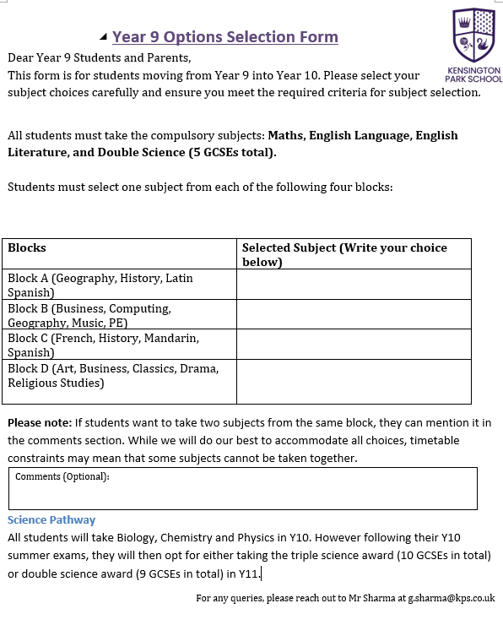
Year 9 Options Form Explanation
Students must select one subject from each of the four blocks.
Blocks have been designed based on student survey preferences.
If students want to take two subjects from the same block, they can mention it in the comments section.
Science pathway selection: Students will start with all 3 sciences and can later opt for a either Double or Triple Science award in Year 11.

Slide 44
FAQs for Year 9 -> Year 10
How many GCSEs will I write?
Every student with write at least 9 GCSEs. However if you want to pursue STEM based subject at A-levels or university, you can write GCSE Science triple award instead of double science but you make that choice with your science teacher at the beginning of Year 11. That would take the number of your GCSEs to 10.
Can I select same subject in two blocks?
No. For example, you cannot select history twice.
Can I pick two languages?
Yes, if the blocking allows, you may.
Can I pick two creative arts?
Yes, if the blocking allows, you may.
Do I have to select one from each block even if don’t like any of them?
Yes. The blocks have been created based on the preliminary survey. However, if you still have any reservations please explain it in comment section or write to Mr Sharma (g.sharma@kps.co.uk)

Slide 45
Science Pathways: Double vs. Triple Science
All students begin with all three sciences)
In Year 11, students can opt for Triple Science (10 GCSEs total) or Double Science award
Decisions will be based on performance, interest and teacher recommendations.
Consultation with the Science department is required to assess the feasibility.

Slide 46
Next Steps
Parents and students are requested to review subject choices carefully
An online form will be shared this week for final selections
The deadline for submissions will be 24th February 2025
If you have any queries, please reach out to the school for guidance. G.Sharma@kps.co.uk

